Slide 1
Lab 01
How to Survive &
Introduction to Git
Software Studio
DataLab, CS, NTHU

Slide 2
Notice
These slides will focus on how to submit you code by using Git command line
You can also use other Git GUI tool or built-in Git tool in other IDE/editor

Slide 3
Outline
General Rule
Introduction to Git
Version control
Git Basics
Try Git!
Remote Repositories
How to Submit Your Code to Gitlab
Tools & References

Slide 4
Outline
General Rule
Introduction to Git
Version control
Git Basics
Try Git!
Remote Repositories
How to Submit Your Code to Gitlab
Tools & References

Slide 5
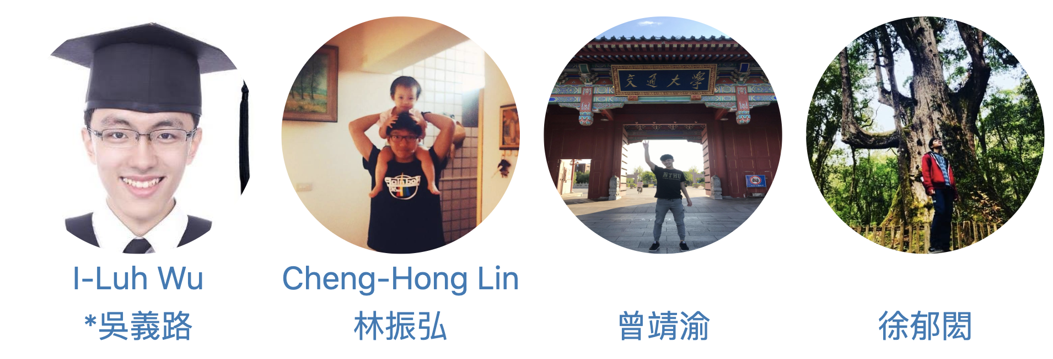
Teaching Assistants

Slide 6
How to Find Us?
Office Hour (TAs)
Wed. 3:30-5:20pm at Delta 729
Email (Personal question only)
Cheng-Hong Lin : chlin@datalab.cs.nthu.edu.tw
I-Luh Wu : ilwu@datalab.cs.nthu.edu.tw
Online Forum
iLms

Slide 7
If I have Question?

Slide 8

If I have Question?
Always Google first !
Learn how to google is important.
If you try your best but still can’t catch it.
Feel free to ask us on iLMS or office hour.

Slide 9
The Policy of Labs
All labs need to be submitted to GitLab.
Late submission will not be accepted.
Plagiarism will not be tolerated.
If we find you copy someone’s code, you will get 0 point for that lab.

Slide 10
Grading Example
4 problems, 25% each
Solved 4 during the lab
100
Solved 3 during the lab, 1 before 11:59pm
75 + 25*0.6 = 90
Solved 4 after the lab, before 11:59pm
100 * 0.6 = 60

Slide 11
Team Up
2~4 people each team
2 people is accepted if you can do as well as others.
Please register your team here before 3/13 23:59
Register form : https://goo.gl/KVeKNE
After that day we will match the rest student.

Slide 12
Outline
General Rule
Introduction to Git
Version control
Git Basics
Try Git!
Remote Repositories
How to Submit Your Code to Gitlab
Tools & References

Slide 13
Why use version control?

Slide 14
We want to track what we did and when we did it.

Slide 15
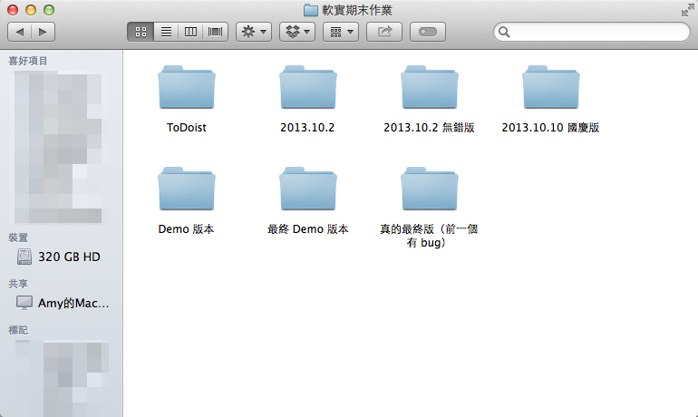
Students’ VCS
Notes:
It is easy to forget which directory you’re in and accidentally write to the wrong file or copy over files you don’t mean to

Slide 16


How to work with others?
?
?

Slide 17
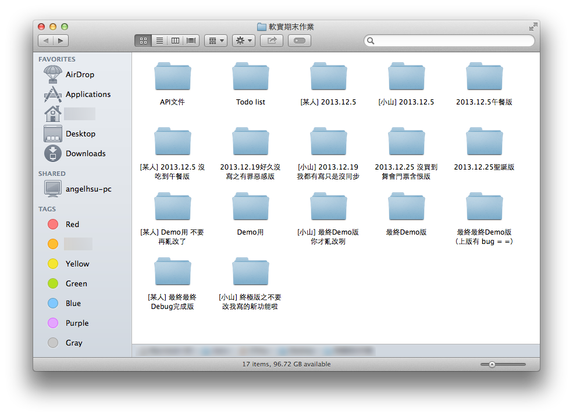
Dropbox VCS in Reality
Dropbox VCS in Reality

Slide 18
Why use VCS?
Managing your projects - tracking your files and modifications.
Synchronization between modifications made by different developers.
Revision history is still very helpful even if you work alone.

Slide 19
Outline
General Rule
Introduction to Git
Version control
Git Basics
Try Git!
Remote Repositories
How to Submit Your Code to Gitlab
Tools & References

Slide 20
Git

Slide 21
Git
Git is a popular version control system which is
Fast
Easy to use
Distributed
A git repository is a mini database that tracks your files.

Slide 22
Git Workflow (1/2)
With a local repository in your computer, you’ll need following operations to make git track your work:
Create/modify files
Let git monitor the files by adding them to staging files.
Commit your changes to and git will create snapshots (versions) of the files for you.

Slide 23
Git Workflow (2/2)
Modifying Files
add
modify file
Staging Modified Files
Committing A Version
commit

Slide 24
Git Branch
Master
Branching
Merging
Develop

Slide 25
Outline
General Rule
Introduction to Git
Version control
Git Basics
Try Git!
Remote Repositories
How to Submit Your Code to Gitlab
Tools & References

Slide 26

Be Professional

Slide 27
Basic Git Commands
git init
Initialize a repository at current directory.
git add [file_name]
Add files to git repository and let git track them.
git commit -m "commit messages"
Save the changes to the git repository and create snapshots of the files.
git checkout [version]
Go to a specific version.

Slide 28
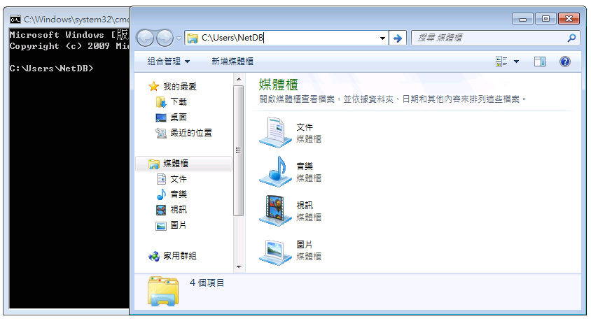
2. Go to that directory
1. Find current directory

Slide 29
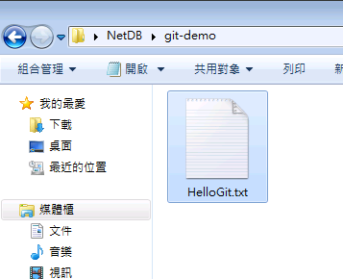
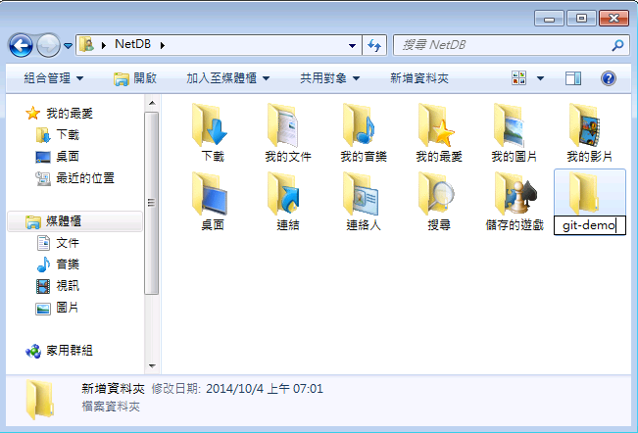
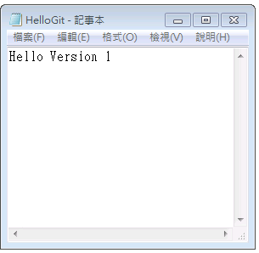
4. Go to that folder
3. Add a new folder
5. Create a new file
6. Put some contents and save

Slide 30
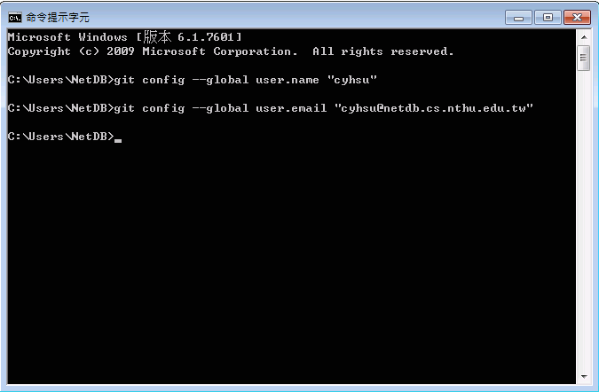
7. Setup user information
With --global: for all repositories in computer
Without --global: for current repository
$ git config --global user.name "name"
$ git config --global user.email "email"

Slide 31
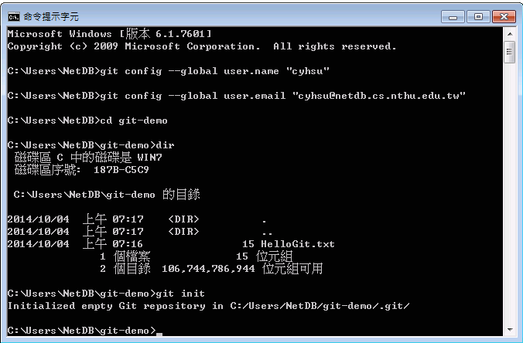
8. Go to “git-demo”
9. Show the files in “git-demo”
10. Initialize a Git repository
$ cd git-demo # go to git-demo directory
$ dir # list the files
$ git init # initialize a repository

Slide 32
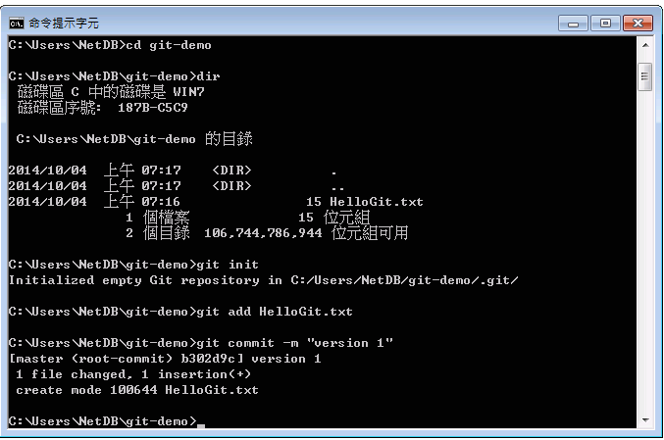
11. Add HelloGit.txt to staging files
12. Commit your changes
# Add HelloGit.txt to staging files
$ git add HelloGit.txt
# Commit the changes to the repository
# where "version 1" is the commit message
$ git commit -m "version 1"

Slide 33
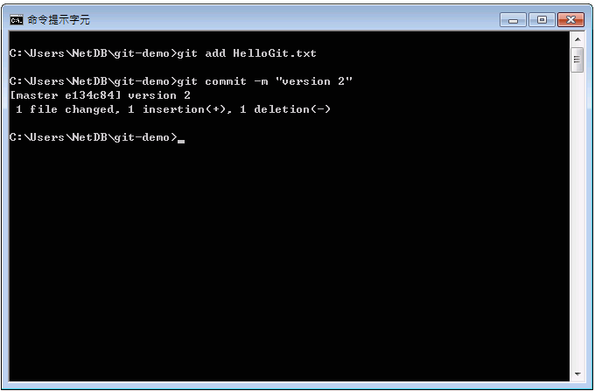
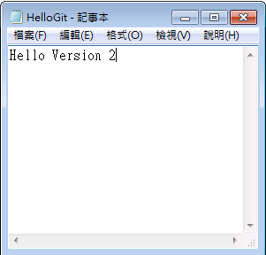
14. Add it and commit again
13. Make some changes and save

Slide 34
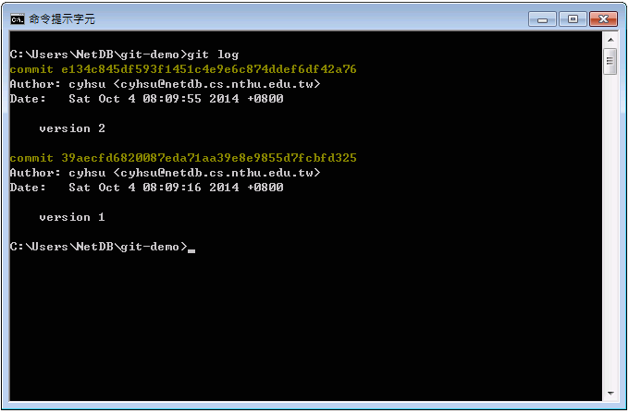

15. View your versions
Version ID
Commit messages
# Show the versions you’ve created so far
$ git log

Slide 35
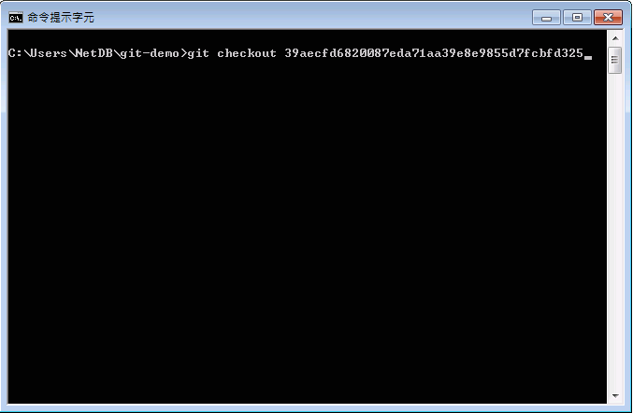
16. Go to a specific version
# Go to a specific version
$ git checkout {version_id}

Slide 36
LIFE IS
TOO SHORT
TO TYPE THAT
VERSION ID!
which is 40 characters long…

Slide 37
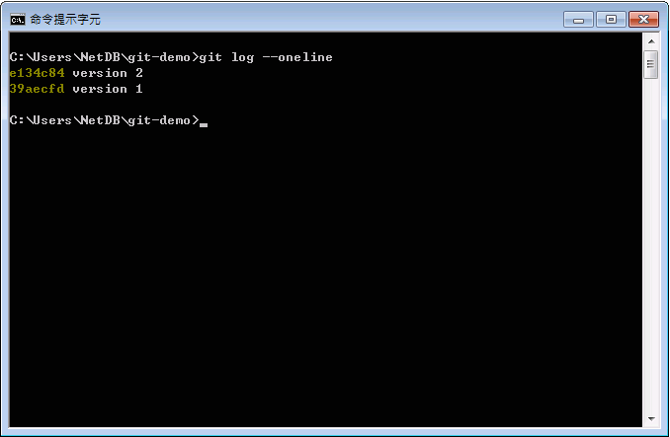
Version ID
15. Show versions with short version ID
56% shorter!
# Show versions with short version id
$ git log --oneline

Slide 38
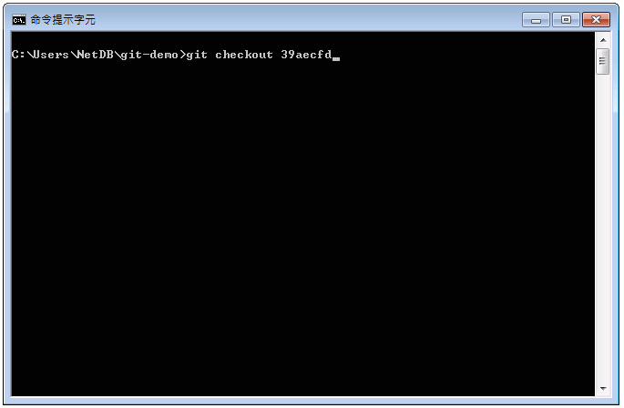
16. Go to a specific version
# Go to a specific version.
# In fact, you only need to type
# the first 5 characters.
$ git checkout {short_version_id}

Slide 39
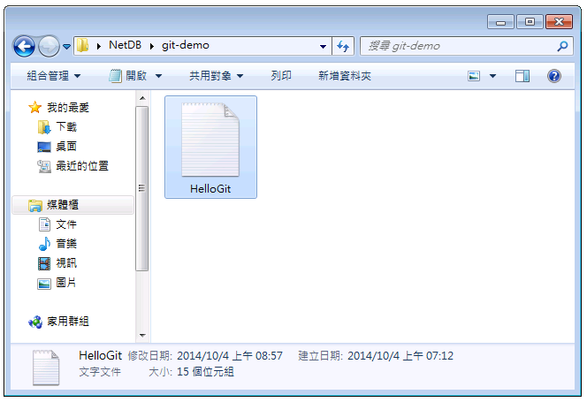
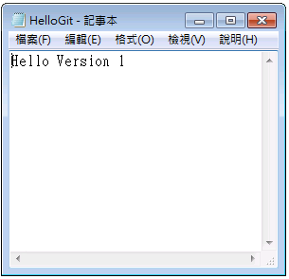
17. Close and reopen HelloGit.txt
18. Back to the version 1!

Slide 40
Try yourself (1/2)
Branching steps
Creating a new branch
Checking out the branch
git branch [branch name]
git checkout [branch name]

Slide 41
Try yourself (2/2)
Merging steps
Checking out a branch to merge
Merging another branch
git checkout [branch 1 name]
git merge [branch 2 name]

Slide 42
Today’s exercise (1/2)
Install Git command line tool in your computer.
Follow appendix A.
Follow above steps.

Slide 43
Outline
General Rule
Introduction to Git
Version control
Git Basics
Try Git!
Remote Repositories
How to Submit Your Code to Gitlab
Tools & References

Slide 44
Collaboration
To work with others using git, you’ll need a server that store the repository.
Git is distributed, which means
Everyone can store a copy of the repository downloaded from the server to their computer and do their jobs independently.

Slide 45
Collaboration Workflows (1/2)
If you don’t have the project, clone (download) the repository from the server.
Do your work and commit the changes at local. Once done, push (upload) the repository to the server.
If someone else modified the project, you can pull (sync) the repository to get the updated project.
Repeat 2 and 3.

Slide 46

Collaboration Workflows (2/2)
Server
Clone
Clone
Local A
Local B

Slide 47

Collaboration Workflows (2/2)
Server
Commit
A
Local A
Local B

Slide 48
Collaboration Workflows (2/2)
Server
Push
A
A
Local A
Local B

Slide 49
Collaboration Workflows (2/2)
A
A
Server
Pull
A
Local A
Local B

Slide 50
Collaboration Workflows (2/2)
A
A
Server
Pull
A
A
Local A
Local B

Slide 51
Why Authentication Failed?

Slide 52
Collaboration Workflow
If you tried to clone the code template from a server and want to push the modified file.
You will get authentication failed.
It’s because it was a project of others, which means you are not able to save the changes back to the server.
So, how can I copy a project from others on a open source platform like Github?

Slide 53

Introducing
Fork

Slide 54

Original Project
A
A2
Open a Merge Request
Forked Project
A
A1
A2
Forked from Red
Commit
Commit

Slide 55
✔︎
Accept
A
A2
A
A1
A2

Slide 56
A
A2
A
A1
A2

Slide 57
Forked from Red A2
A2
A
A
A2
A
A1
A2

Slide 58
Git Collaboration Workflow
Fork a repository to make a copy of it.
Clone the repository you forked to your workspace.
Do your work and commit the changes in your workspace.
Push the repository to the server to synchronize them.
Open a merge request to origin repository .

Slide 59
Basic Git Commands (2/2)
git clone [url]
Clone a repository from remote server
git push [url] [branch-name]
Push committed file to remote server

Slide 60
Outline
General Rule
Introduction to Git
Version control
Git Basics
Try Git!
Remote Repositories
How to Submit Your Code to Gitlab
Tools & References

Slide 62
Gitlab
We have created account for you
Account: student ID (e.g. 106012345)
Password: student ID (e.g. 106012345)

Slide 63
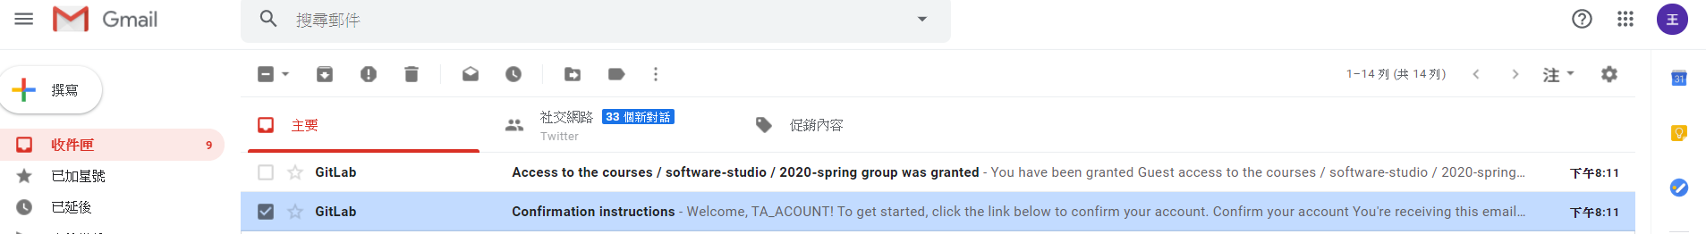
Gitlab

Slide 64
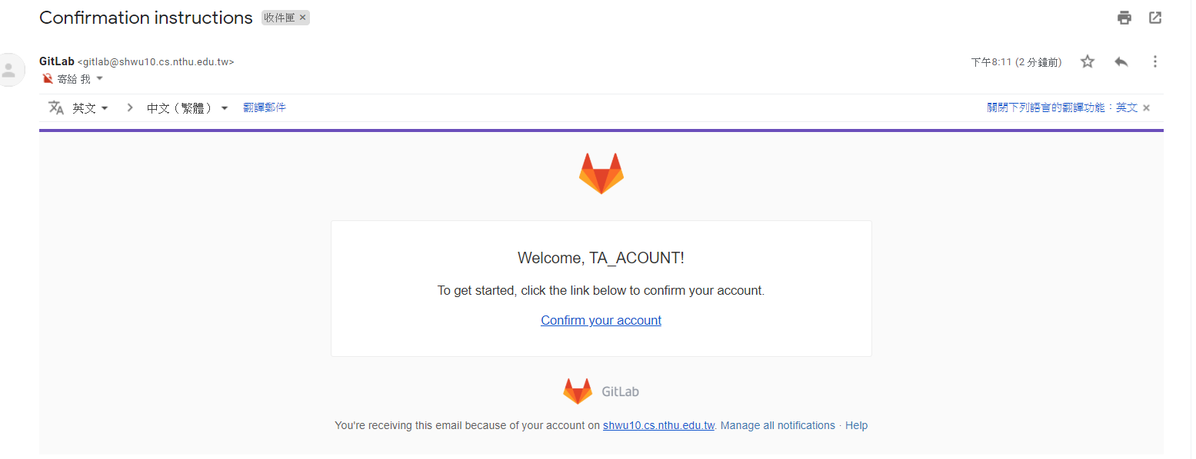
Gitlab

Slide 65
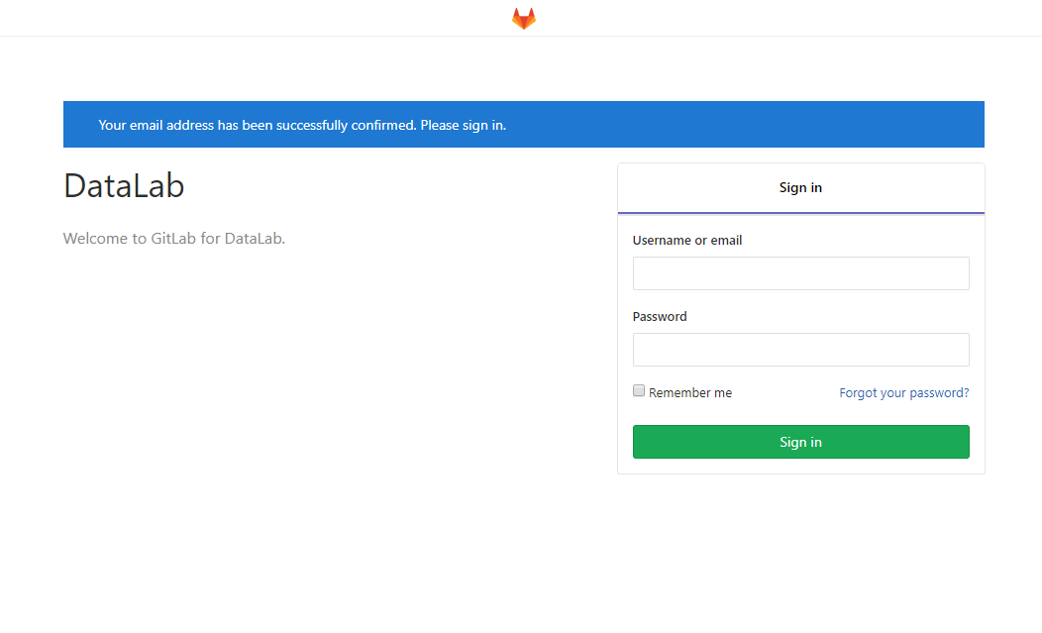
Gitlab

Slide 66
Workflow
For each lab, you should follow the workflow below
Fork our template repository on Gitlab
Clone the forked repository to your computer
Finish your lab
Commit in your computer
Push to Gitlab
Send merge request of your branch to our template repository

Slide 67
Workflow
For each lab, you should follow the workflow below
Fork our template repository on Gitlab
Clone the forked repository to your computer
Finish your lab
Commit in your computer
Push to Gitlab
Send merge request of your branch to our template repository

Slide 68
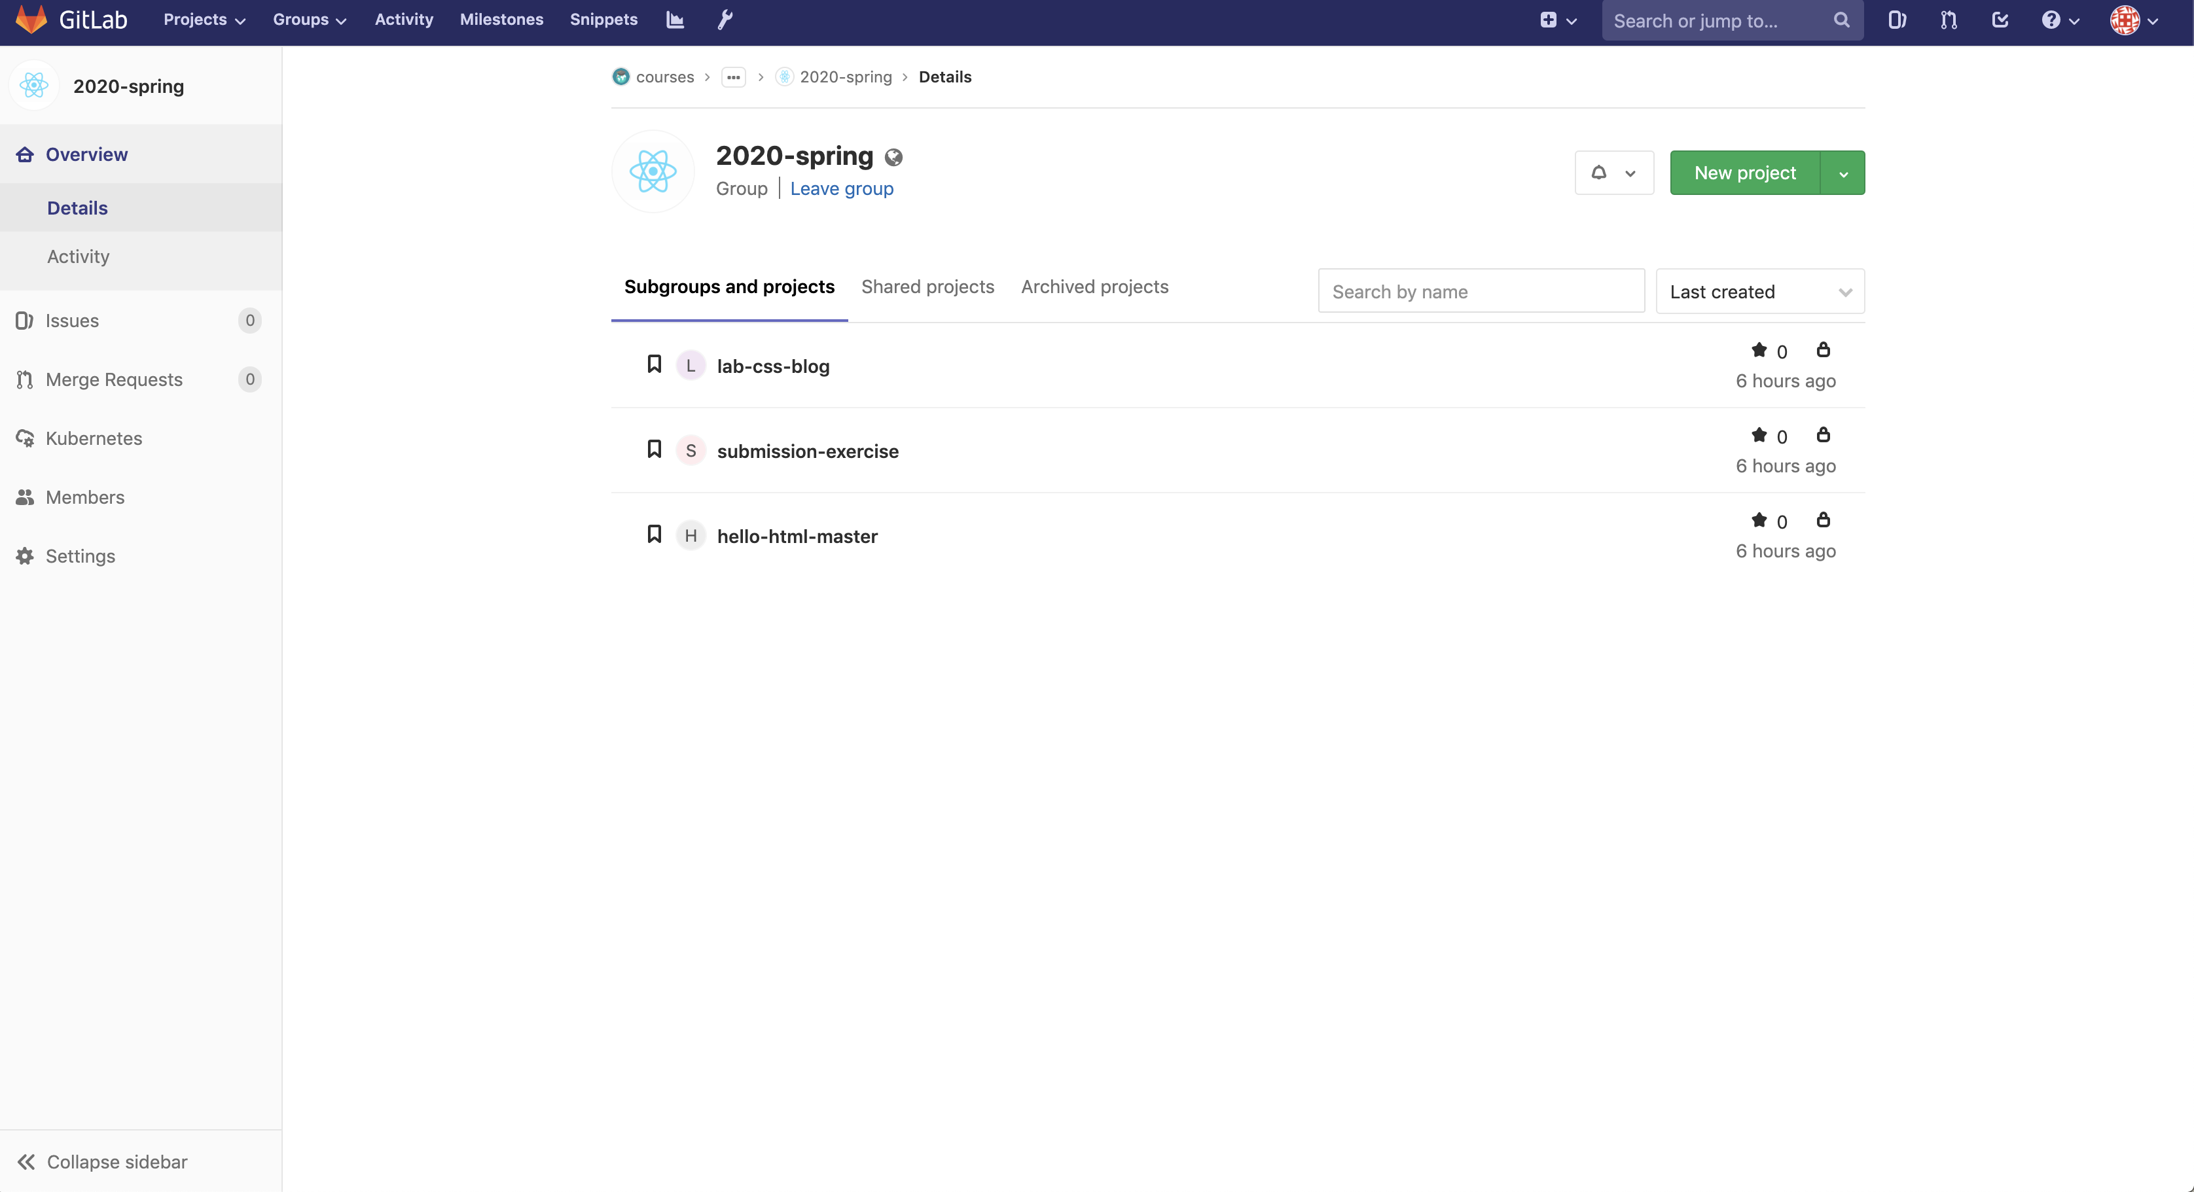
You can access course projects in this group

Slide 69
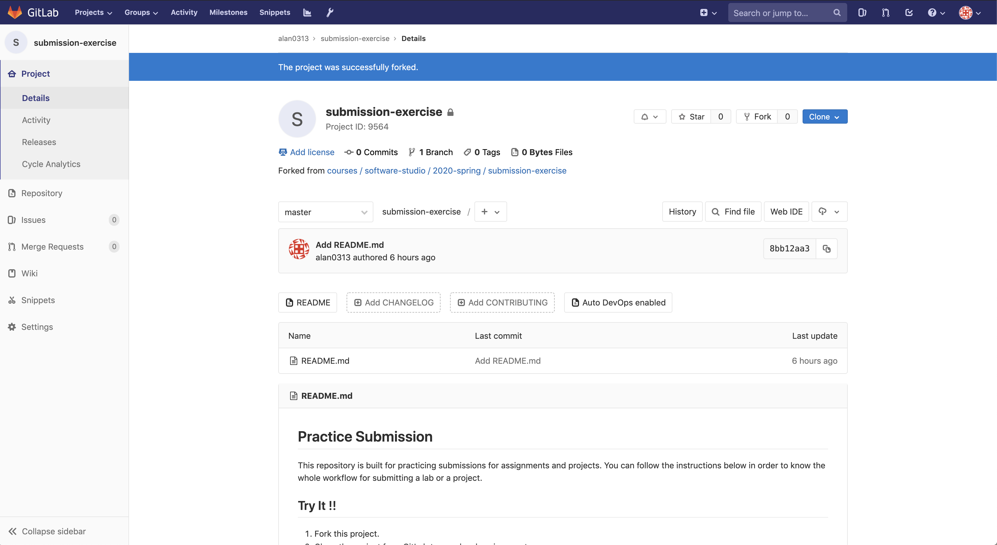
1. Click to fork

Slide 70
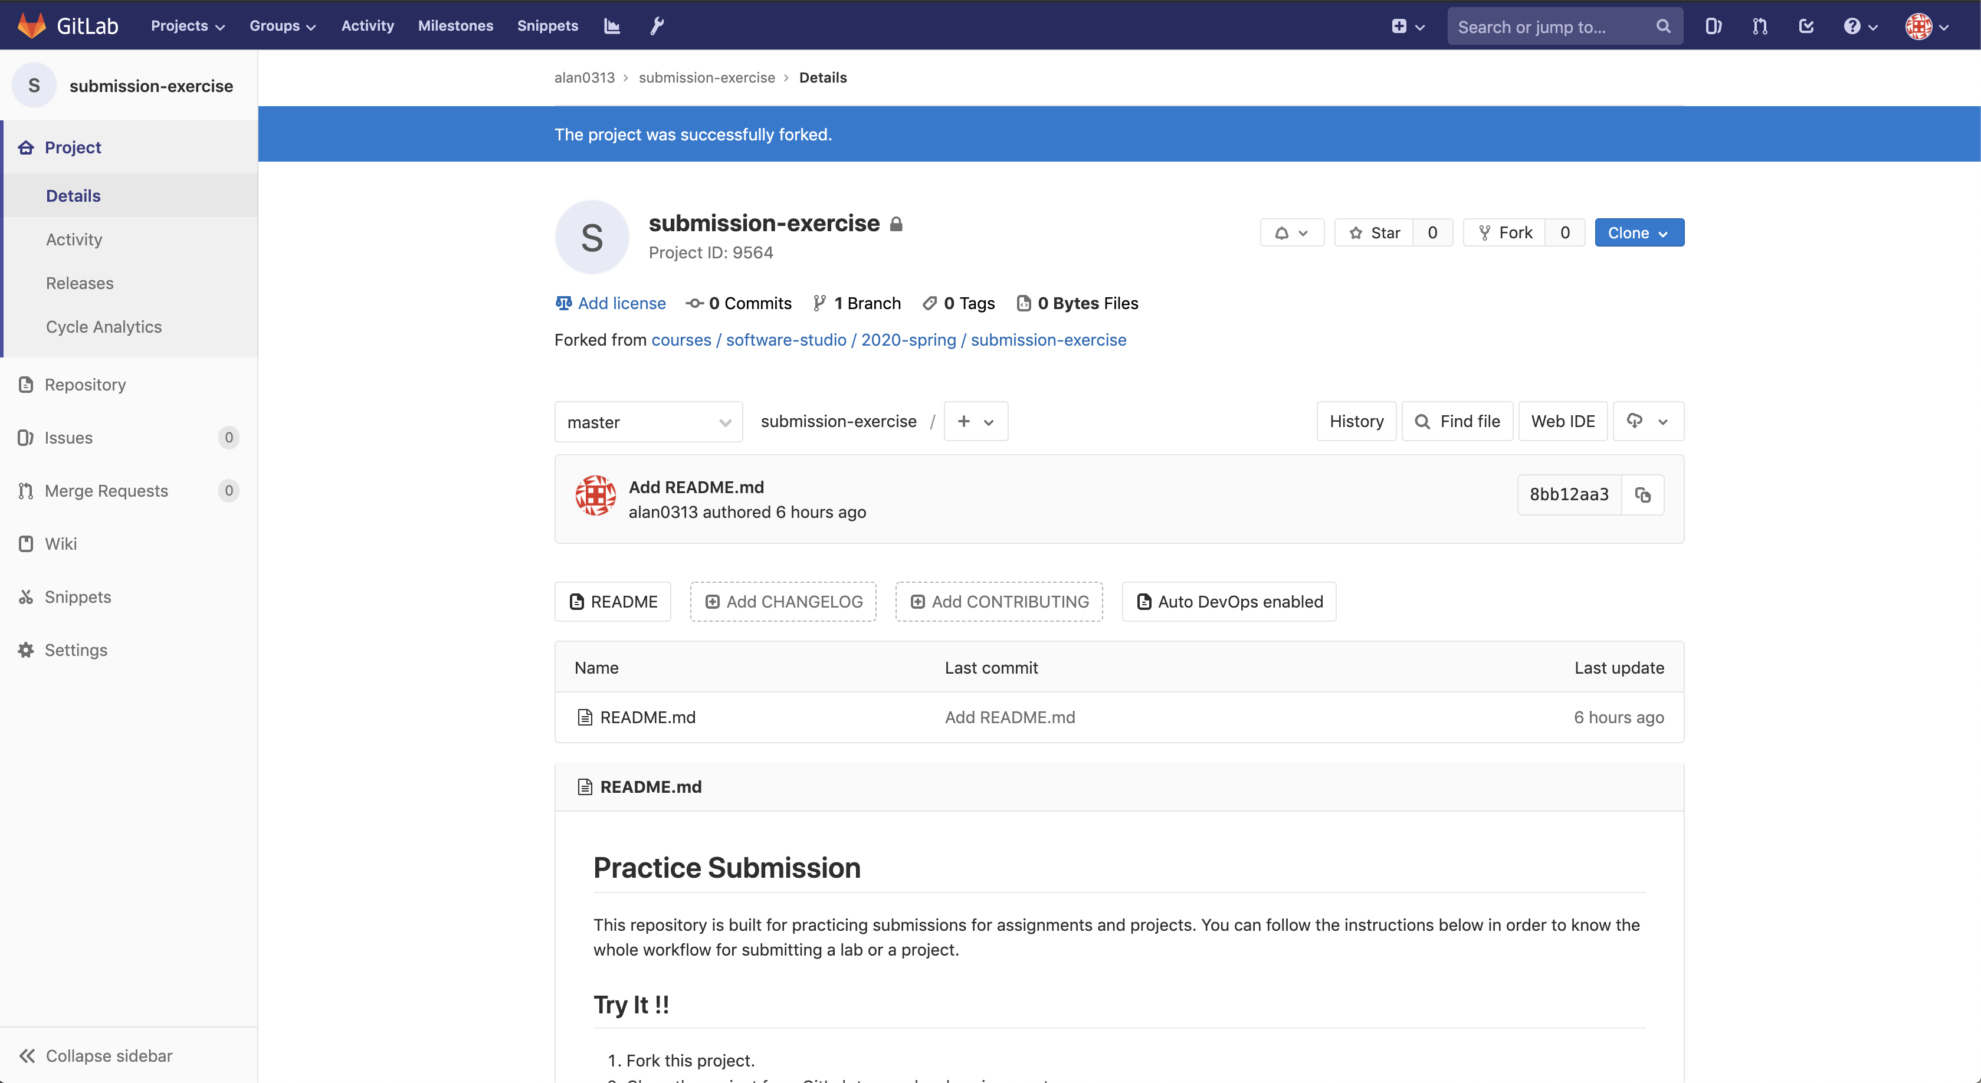
2. Check if this repository is under your account
3. Go to settings

Slide 71
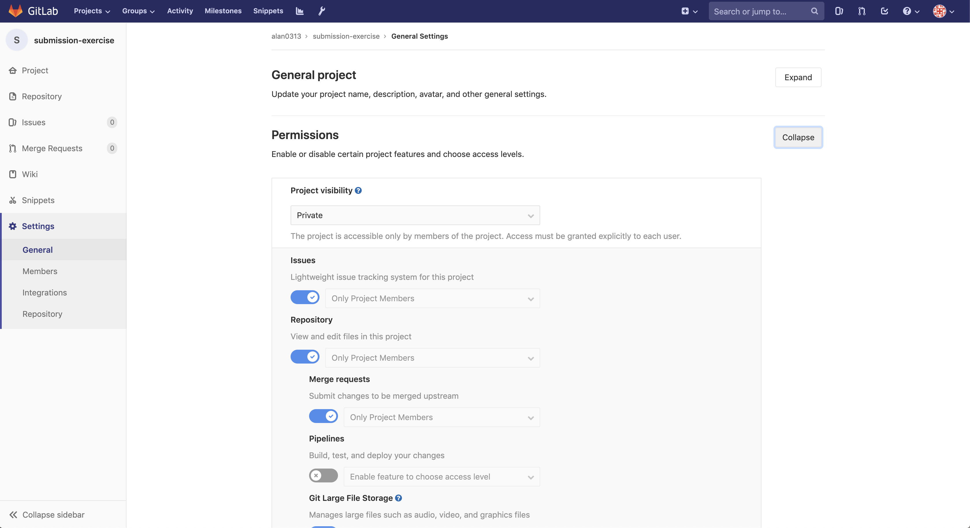
4. Set project to private

Slide 72
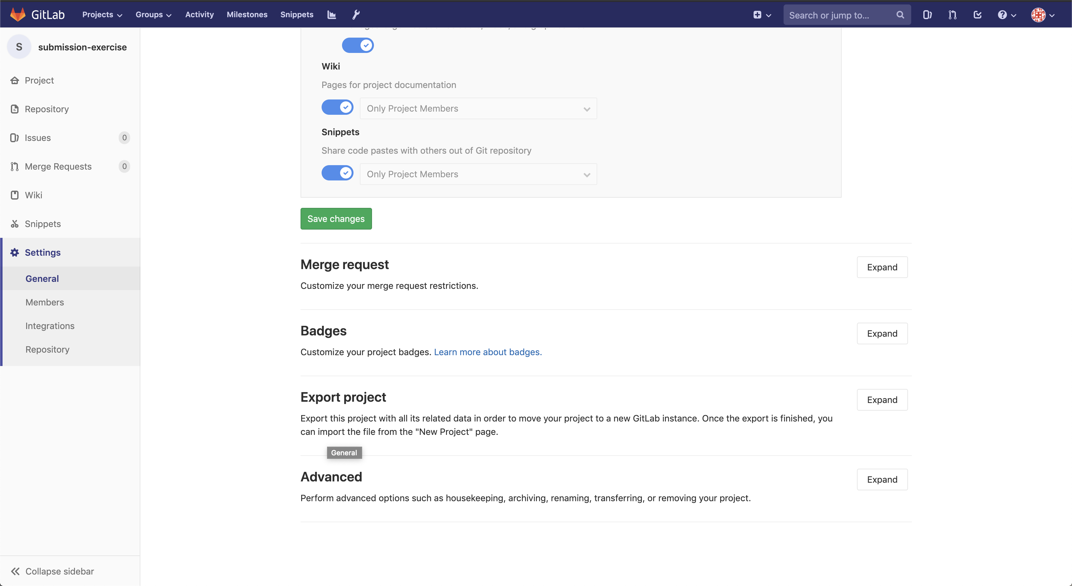
5. Scroll down and save changes

Slide 73
Workflow
For each lab, you should follow the workflow below
Fork our template repository on Gitlab
Clone the forked repository to your computer
Finish your lab
Commit in your computer
Push to Gitlab
Send merge request of your branch to our template repository

Slide 74
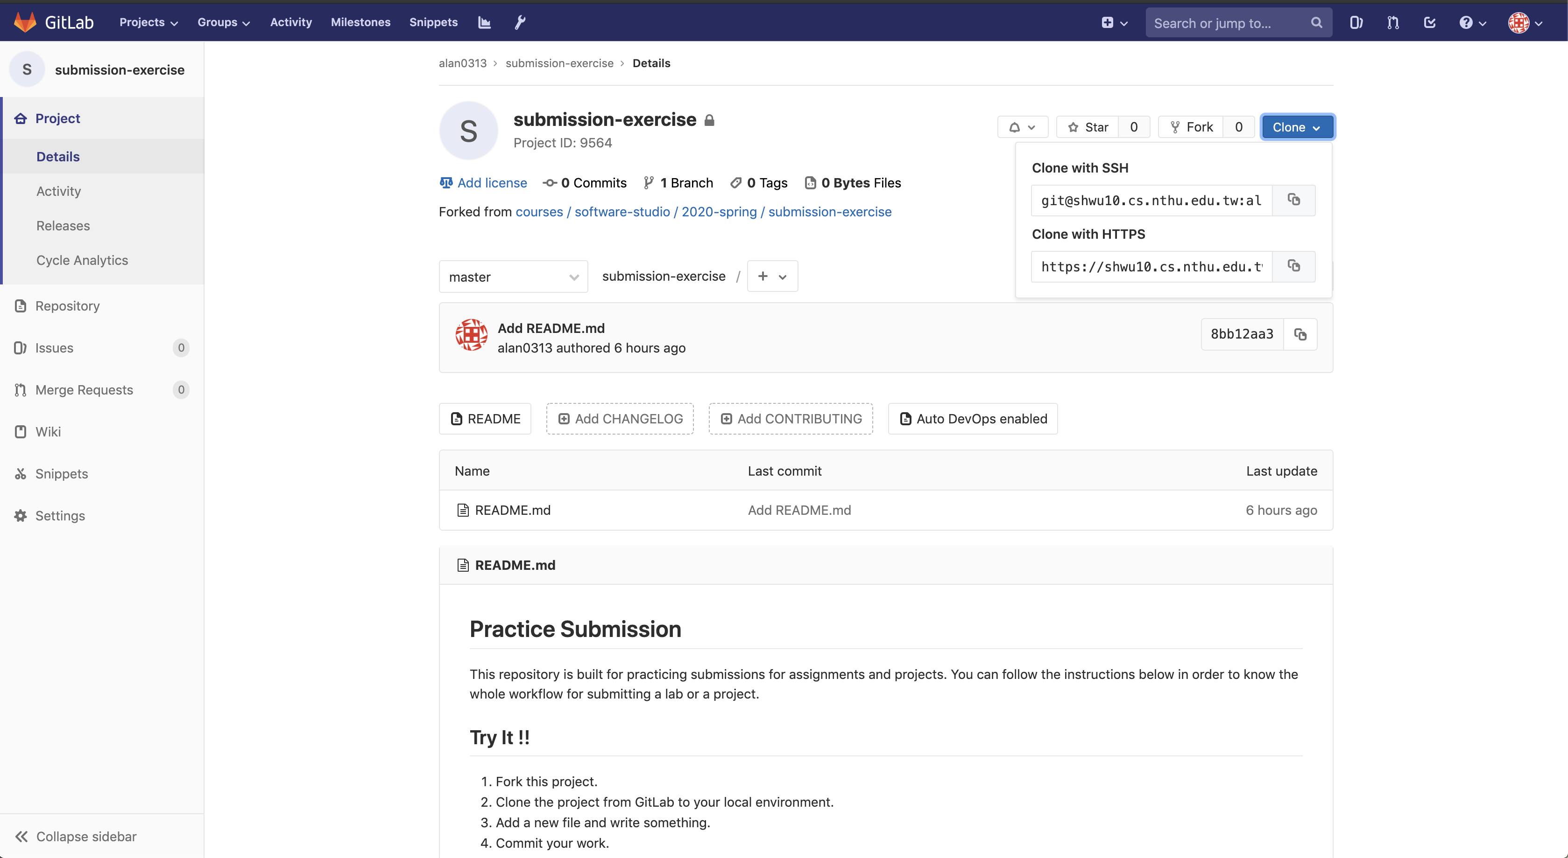
2. Copy the link
1. Choose HTTPS

Slide 75
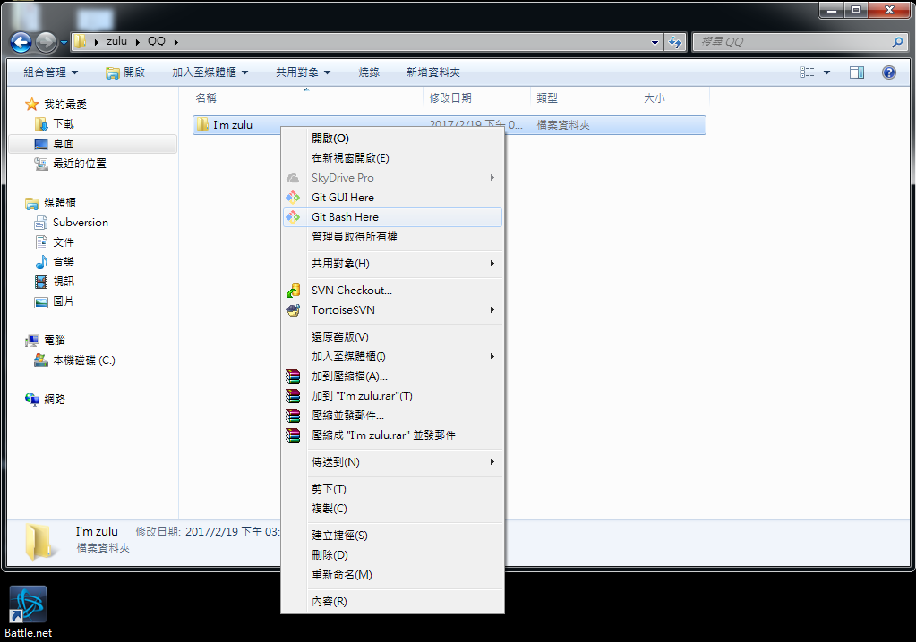

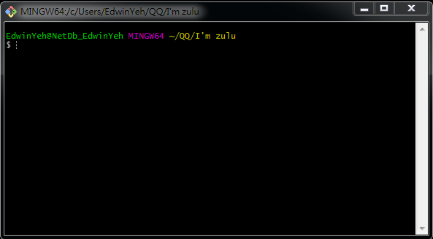
If You use Windows

Slide 76
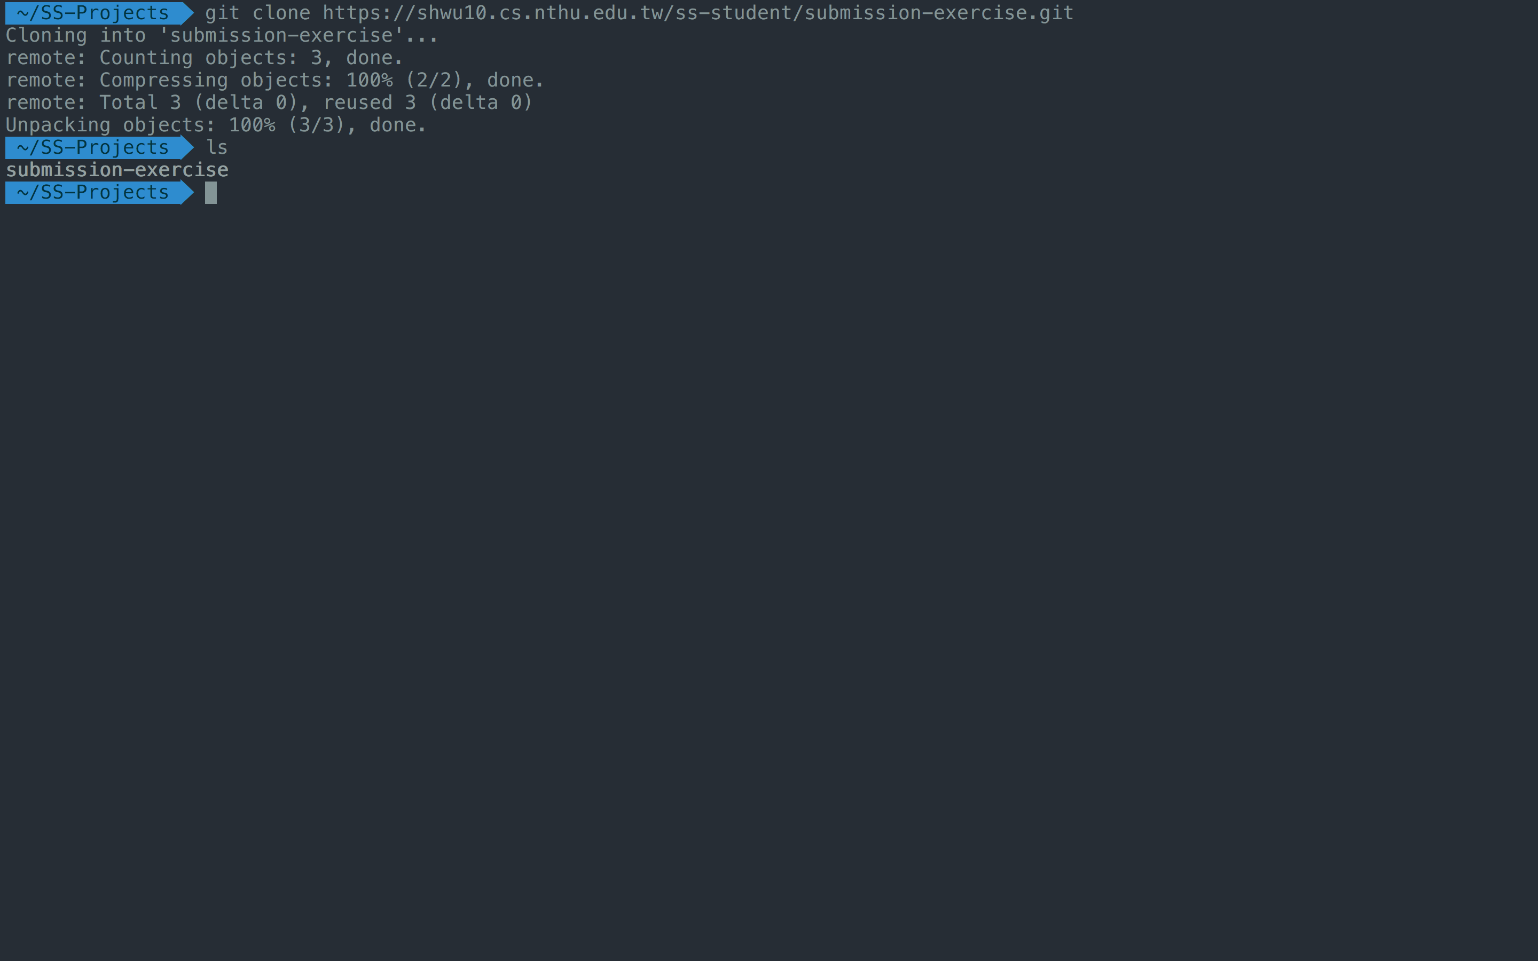
3. Create a folder to put your repos
4. Type "git clone {URL}"
5. The repo has been successfully cloned

Slide 77
Workflow
For each lab, you should follow the workflow below
Fork our template repository on Gitlab
Clone the forked repository to your computer
Finish your lab
Commit in your computer
Push to Gitlab
Send merge request of your branch to our template repository

Slide 78
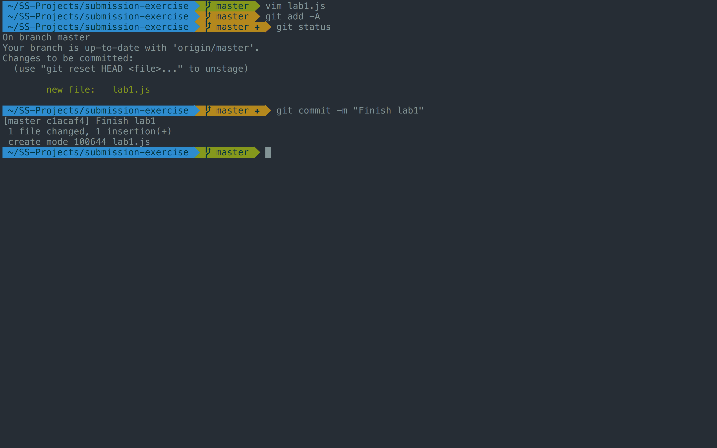
1. -A means all files
2. Check if your file is added to git
3. Commit your changes

Slide 79
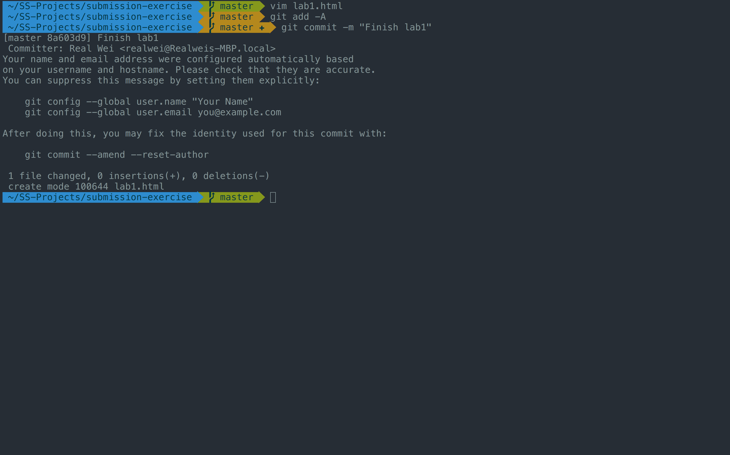
If you see these message, type
git config --global user.name "{name}"
git config --global user.email "{email}"
{email} is the email you use on gitlab

Slide 80
Workflow
For each lab, you should follow the workflow below
Fork our template repository on Gitlab
Clone the forked repository to your computer
Finish your lab
Commit in your computer
Push to Gitlab
Send merge request of your branch to our template repository

Slide 81
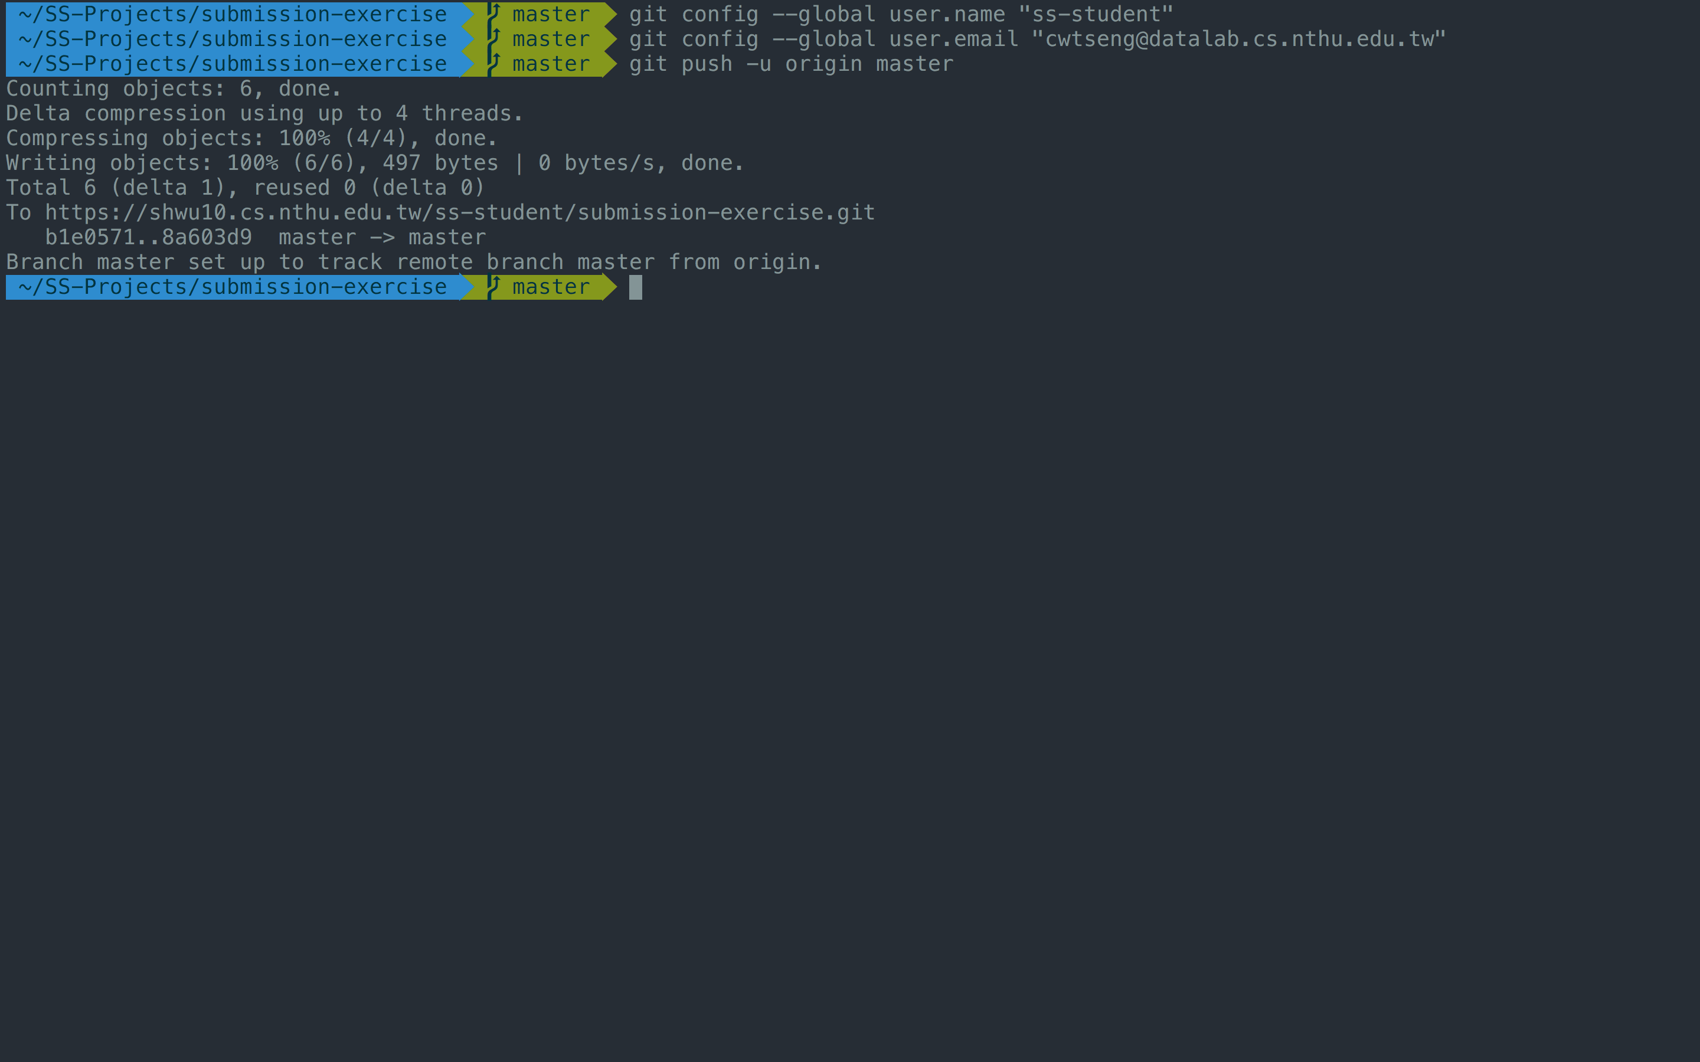
Type "git push -u origin master"

Slide 82
Workflow
For each lab, you should follow the workflow below
Fork our template repository on Gitlab
Clone the forked repository to your computer
Finish your lab
Commit in your computer
Push to Gitlab
Send merge request of your branch to our template repository

Slide 83
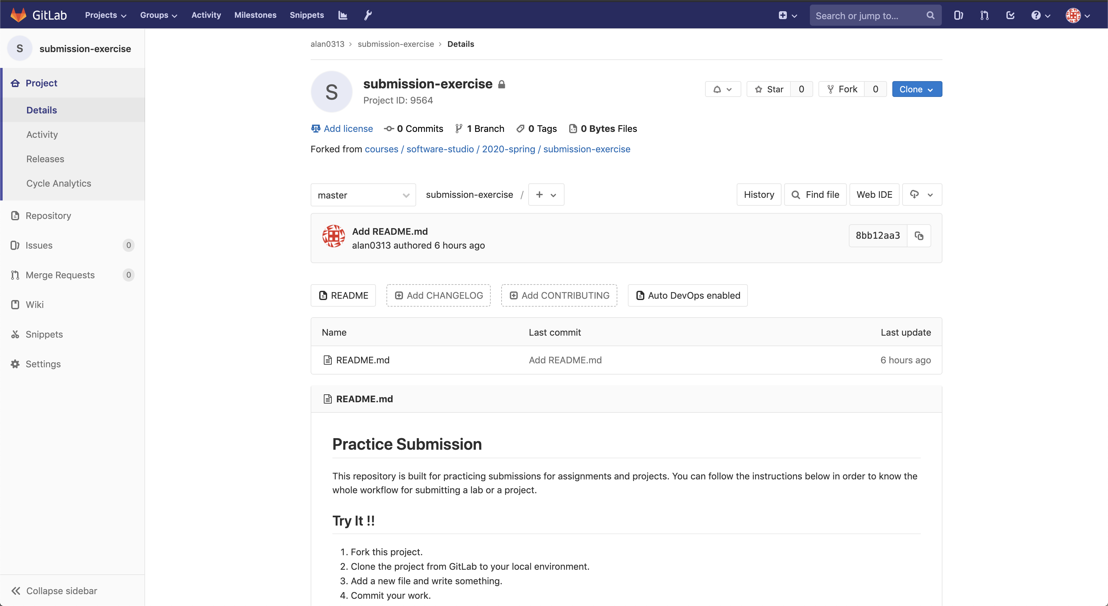
1. Click Merge Requests

Slide 84
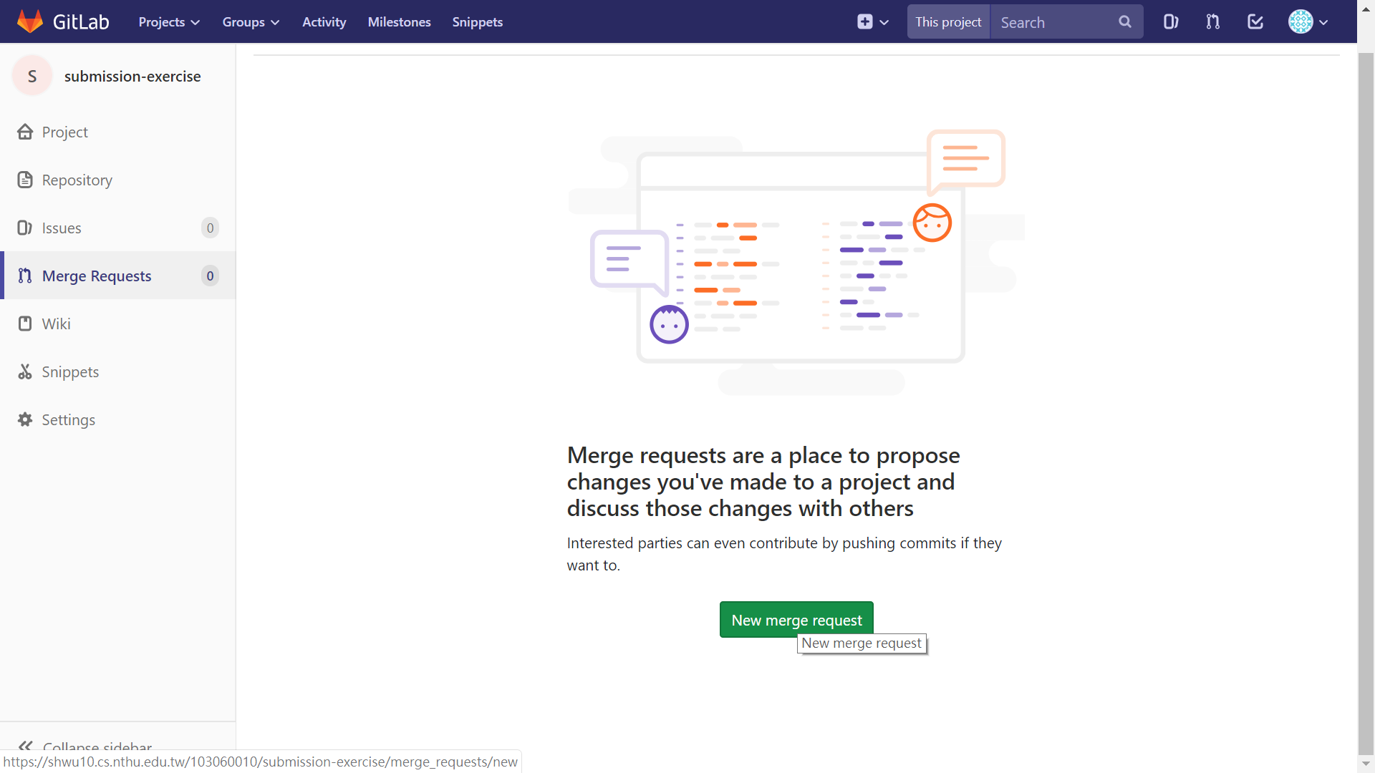
2. New merge request

Slide 85
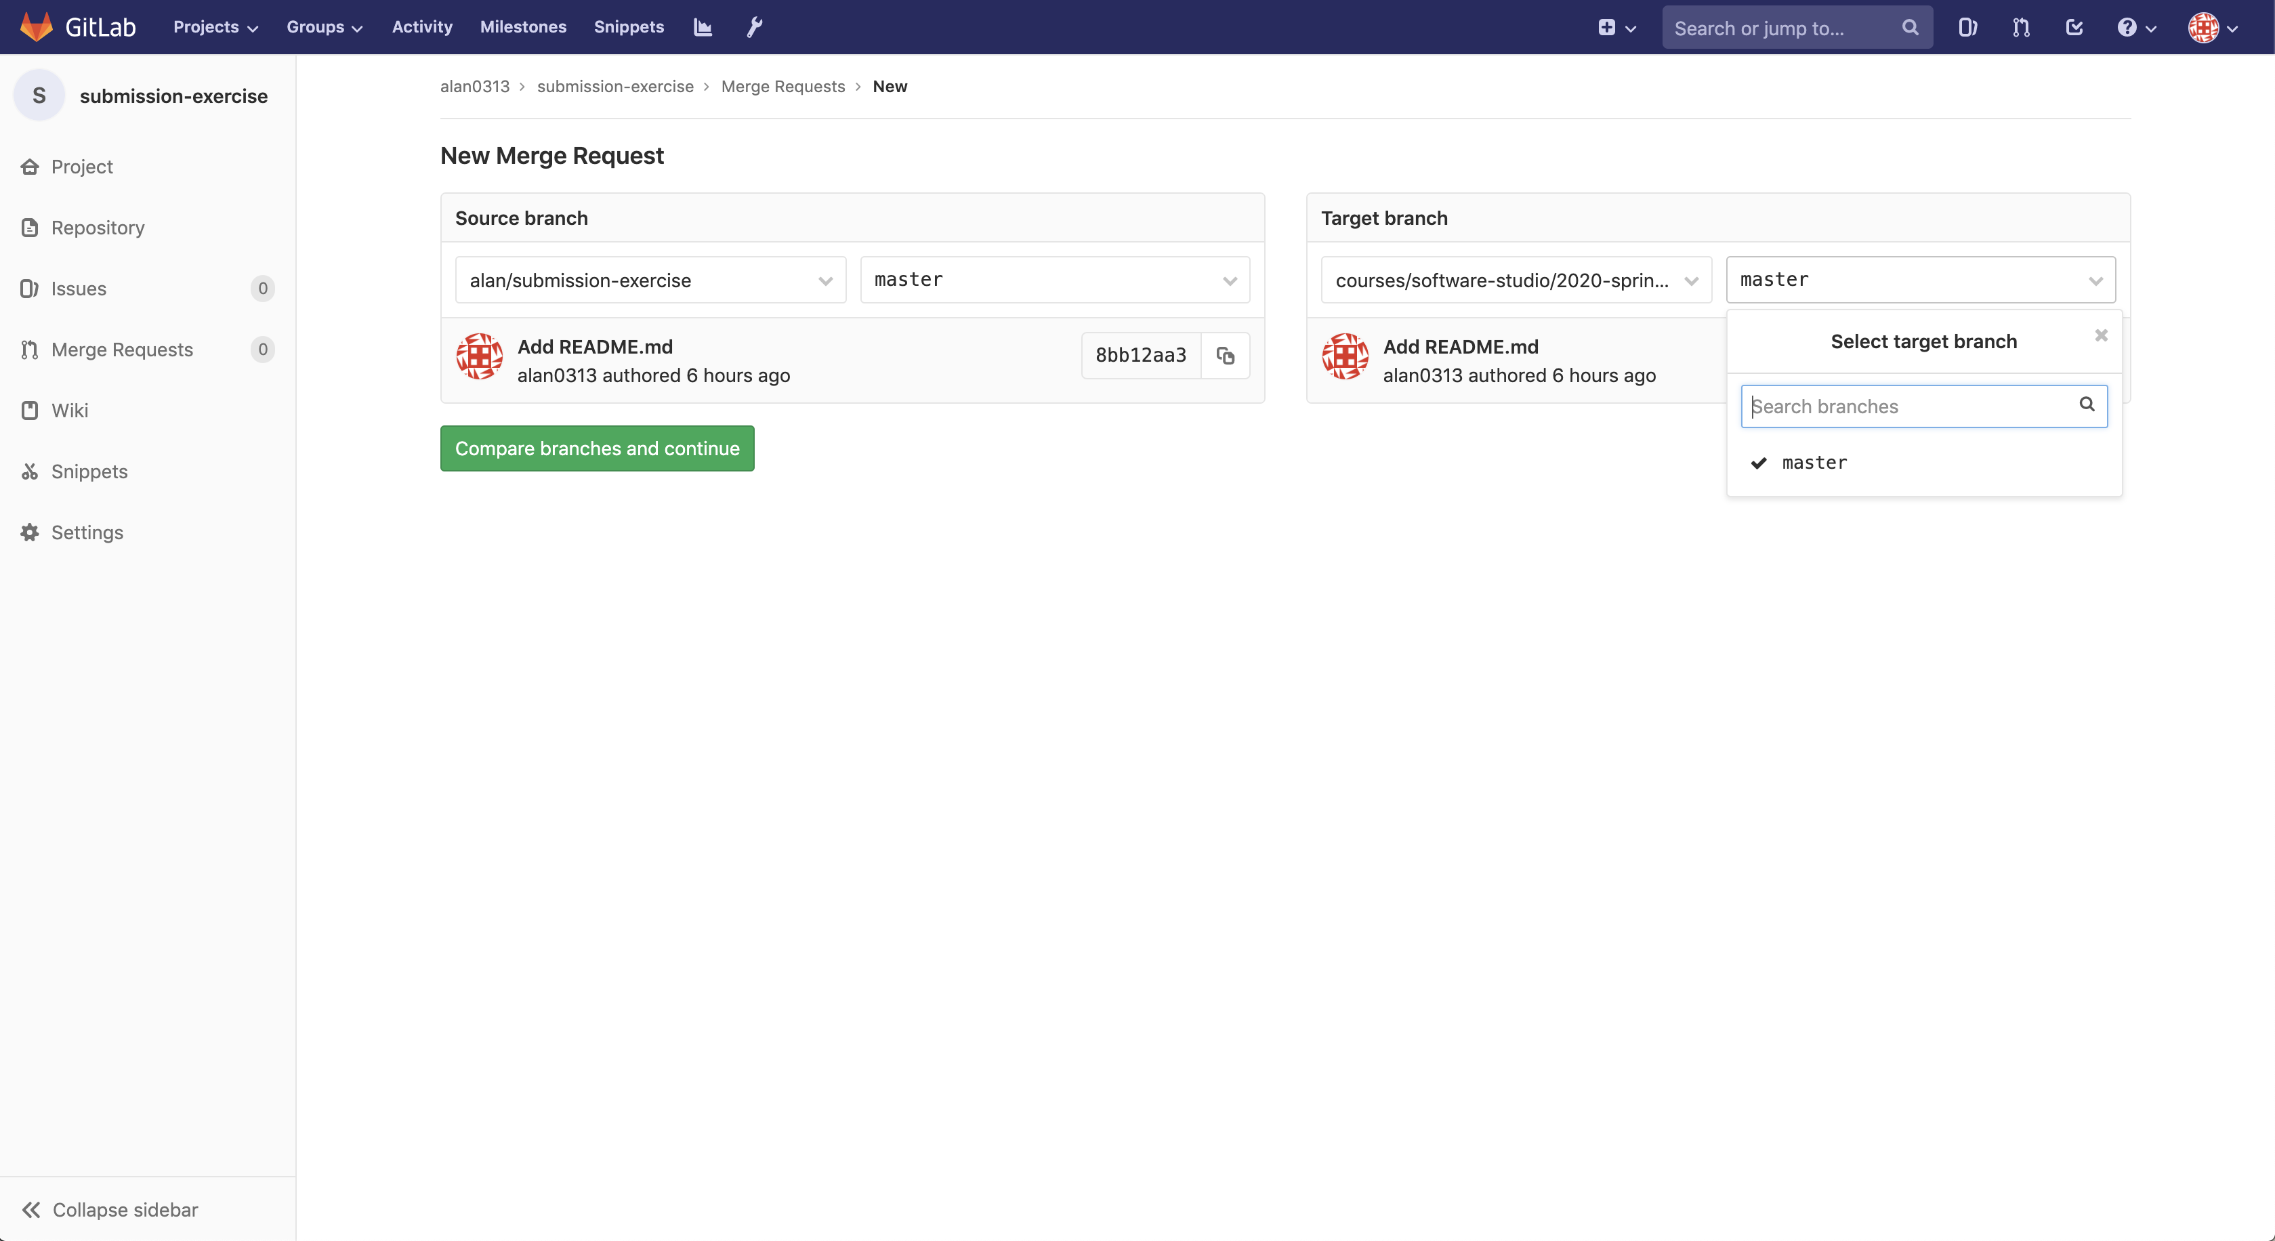
3. Choose the branch you pushed in your repo
4. Choose the branch named after your ID
5. Compare branches

Slide 86
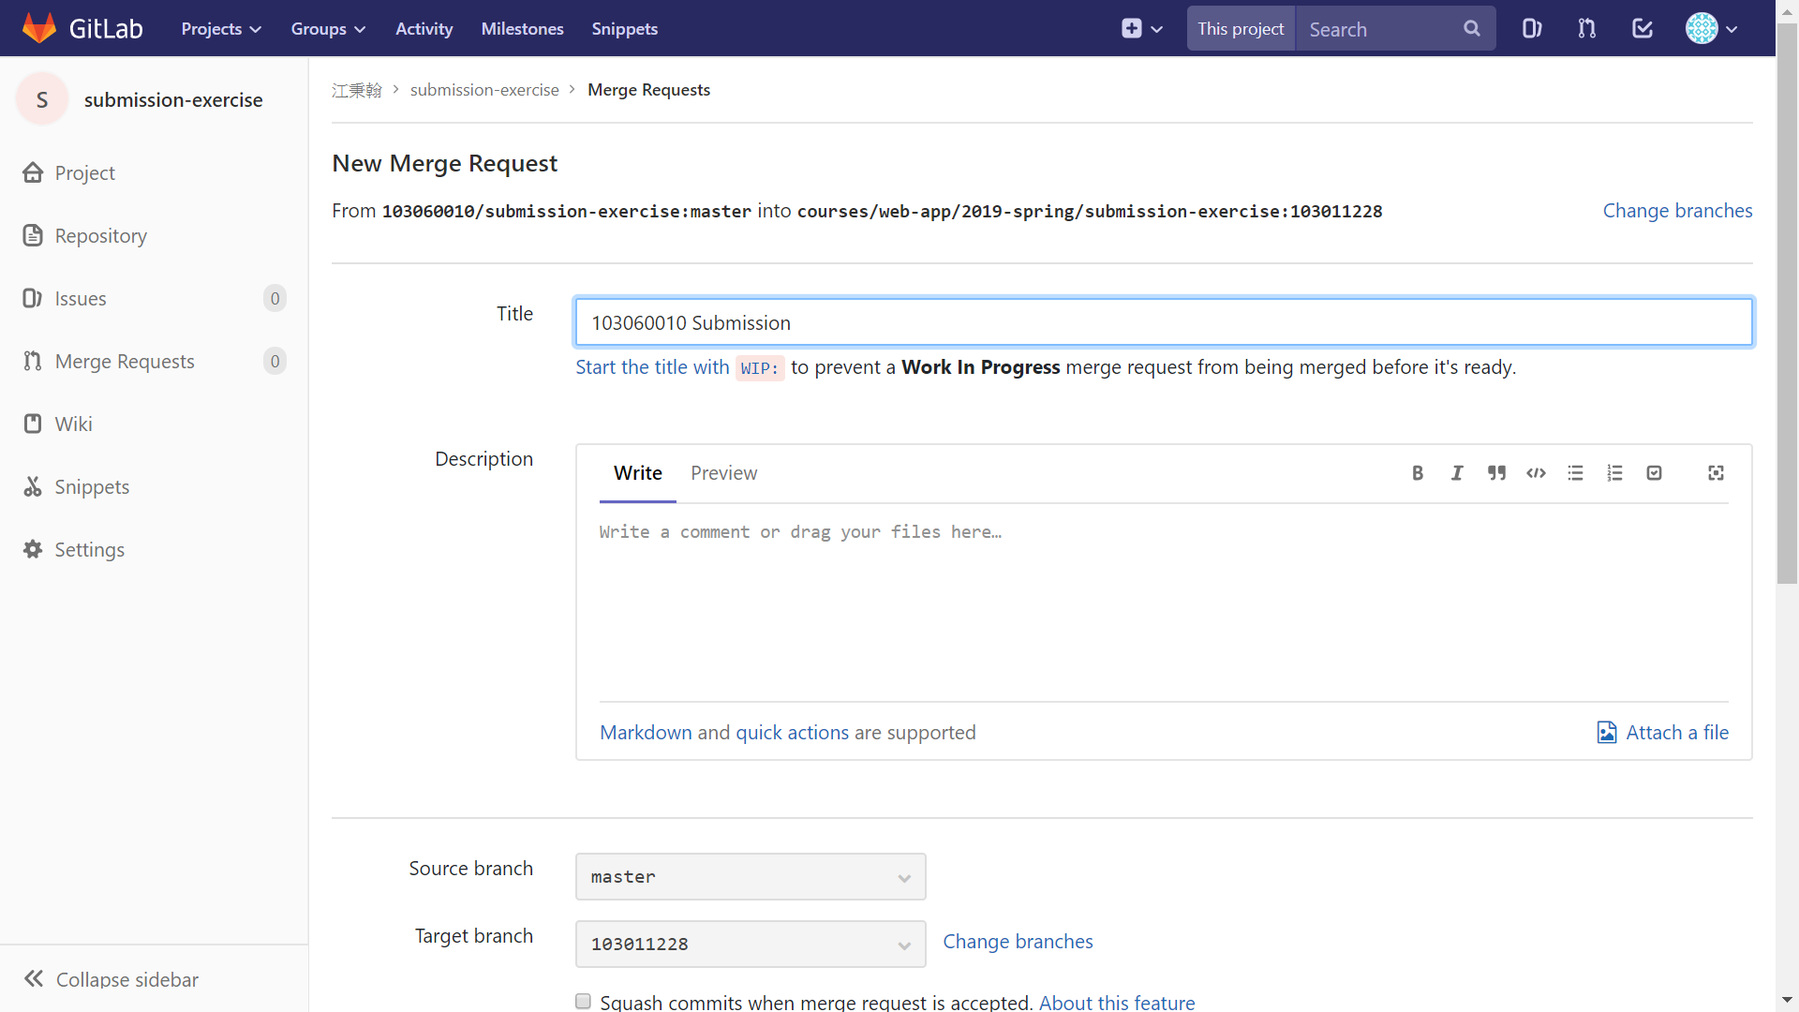
6. Set title to "{ID} Submission"

Slide 87
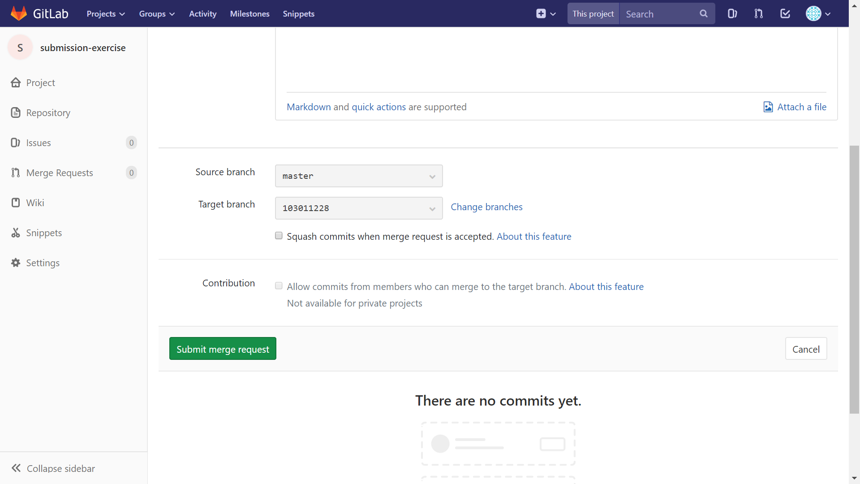
7. If everything is OK,
submit your merge request

Slide 88

Notice

Slide 89
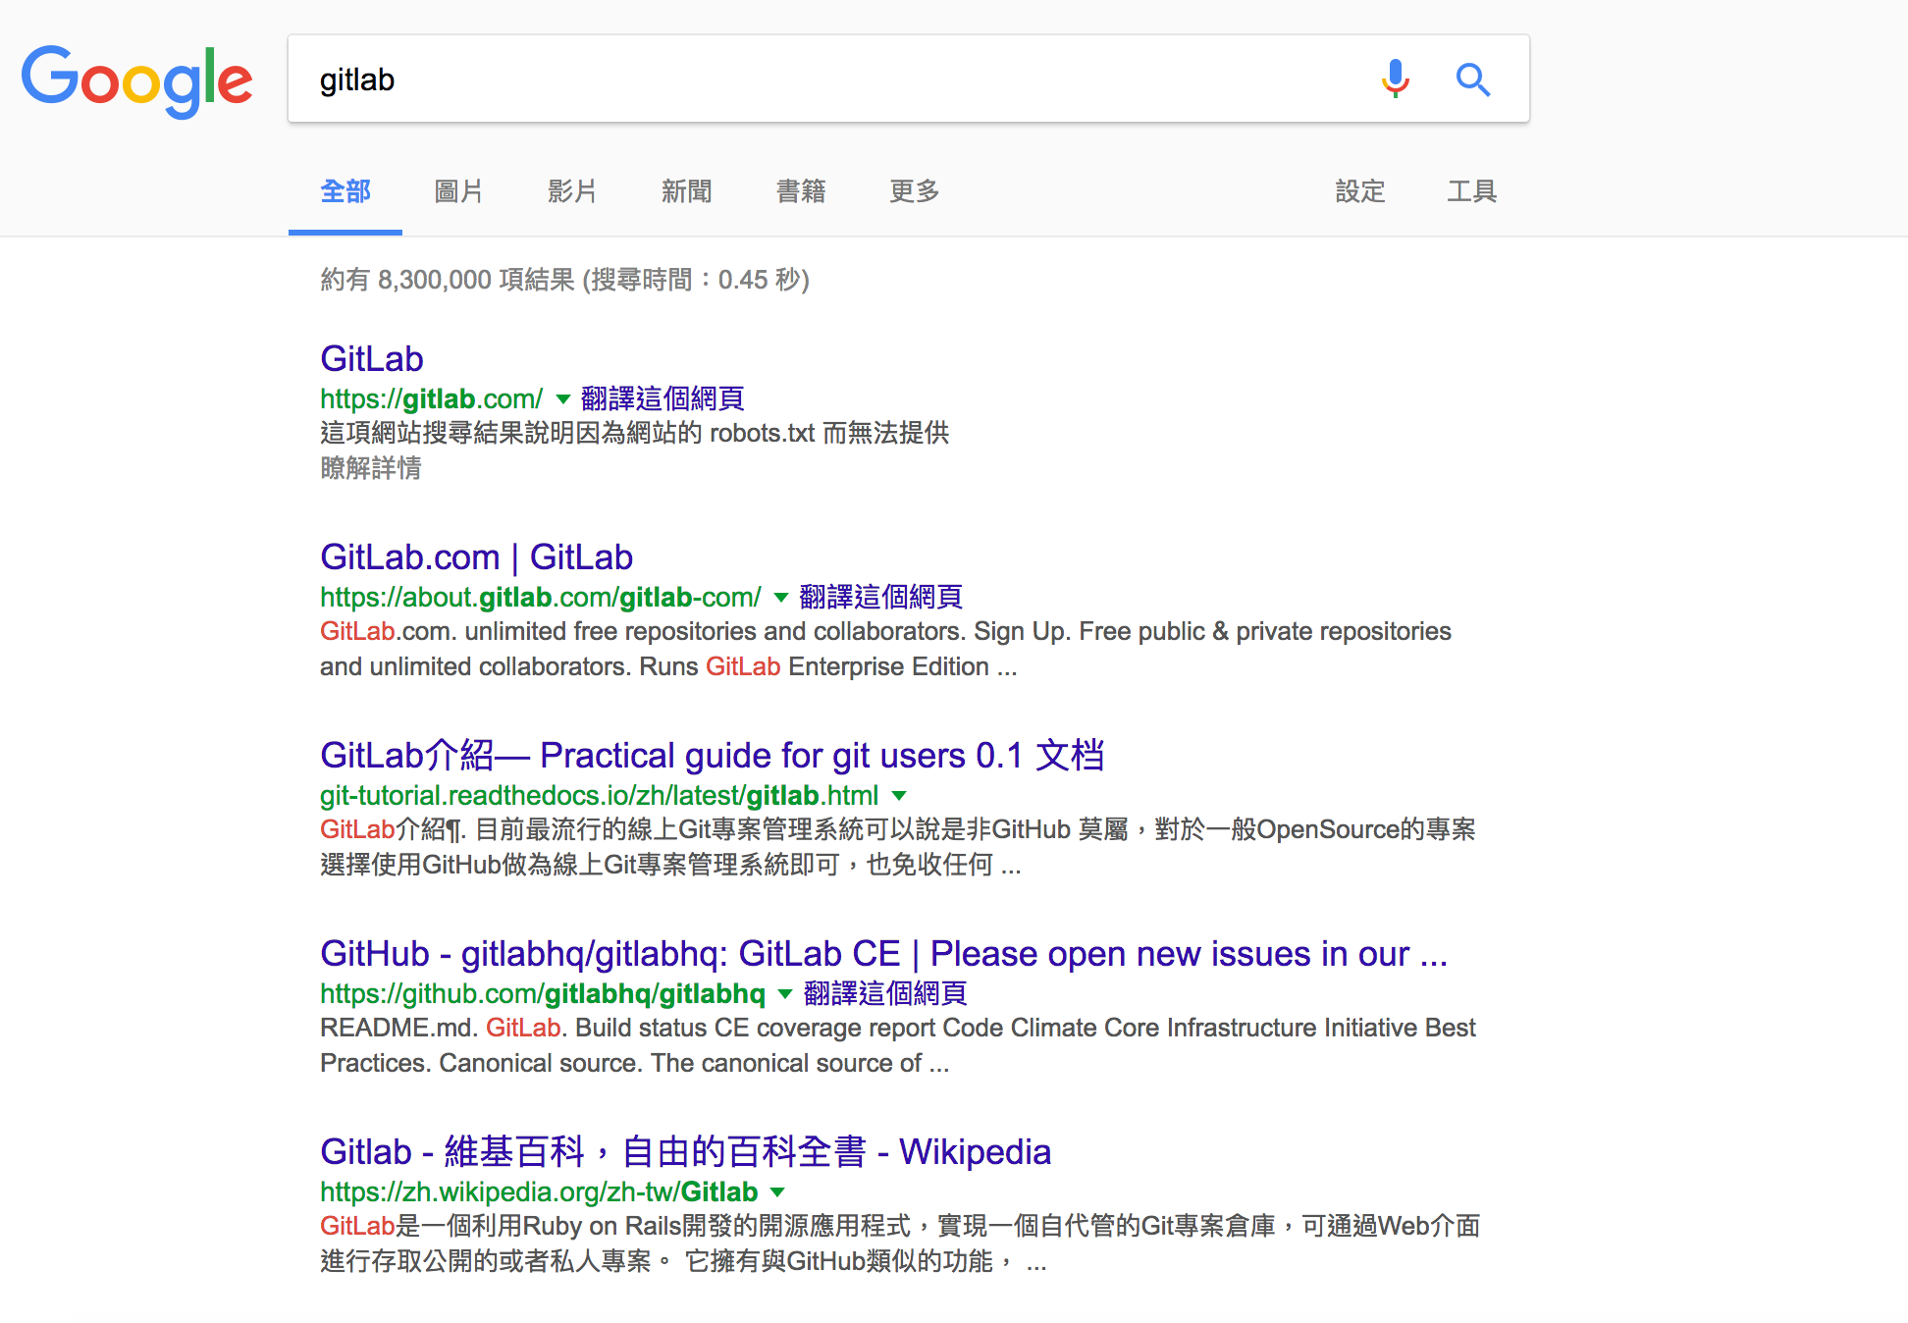

Slide 90
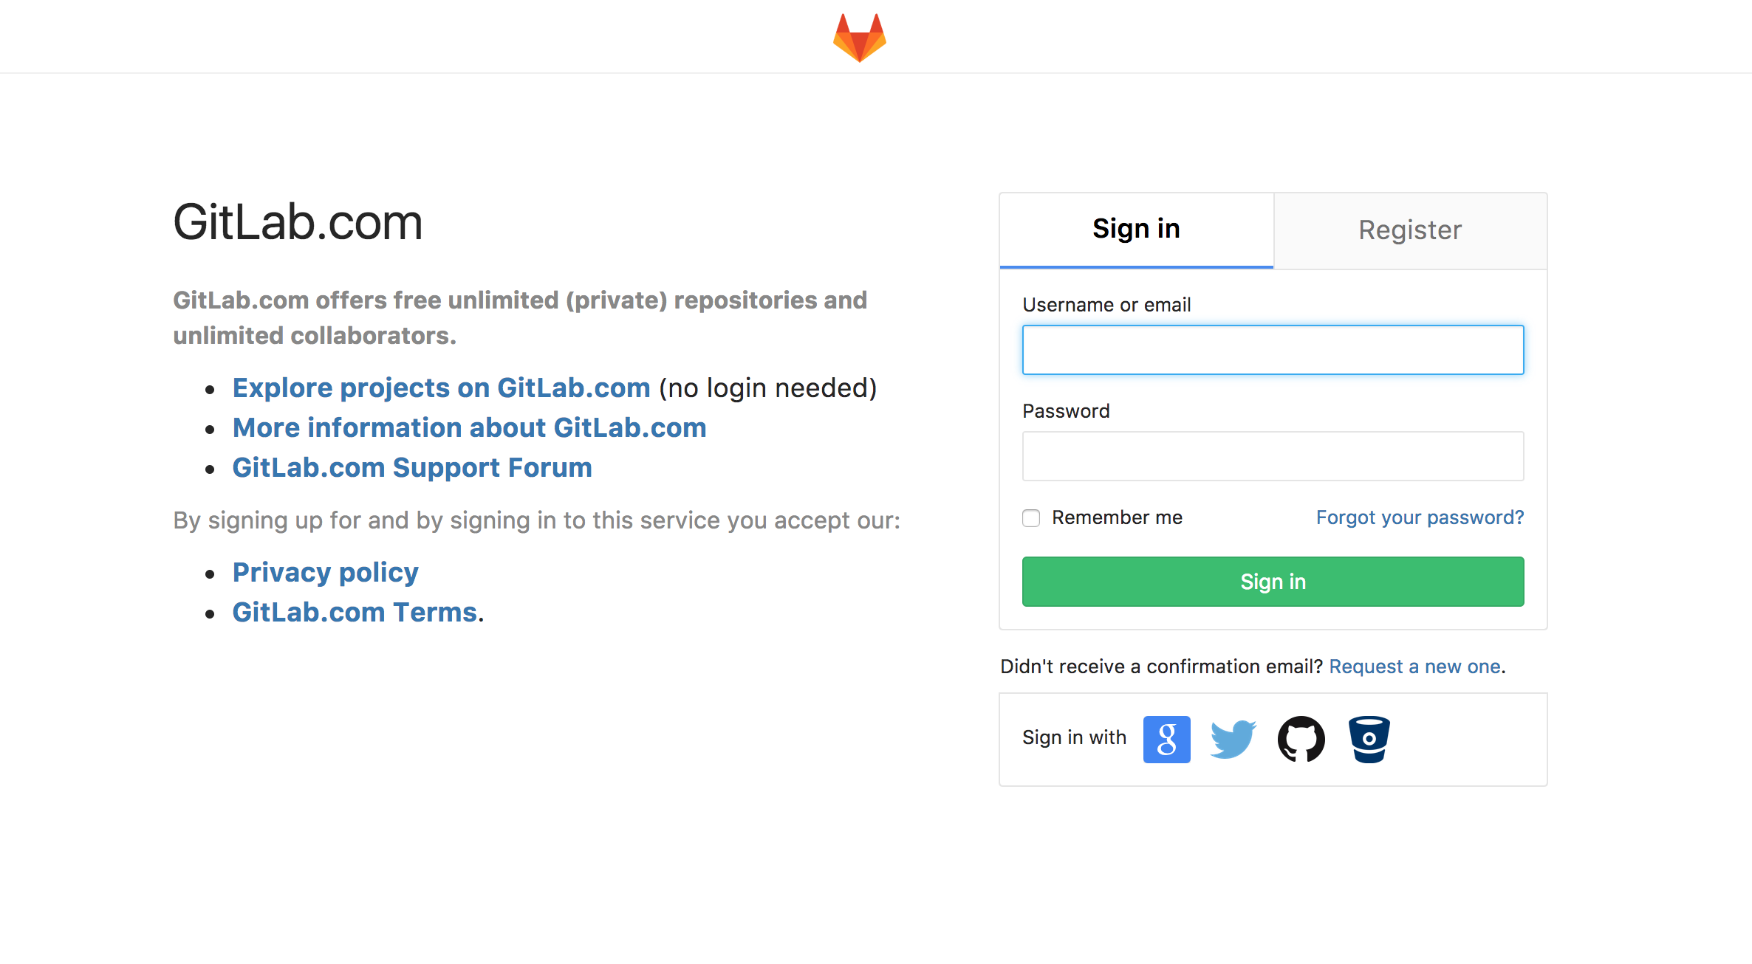

Slide 91

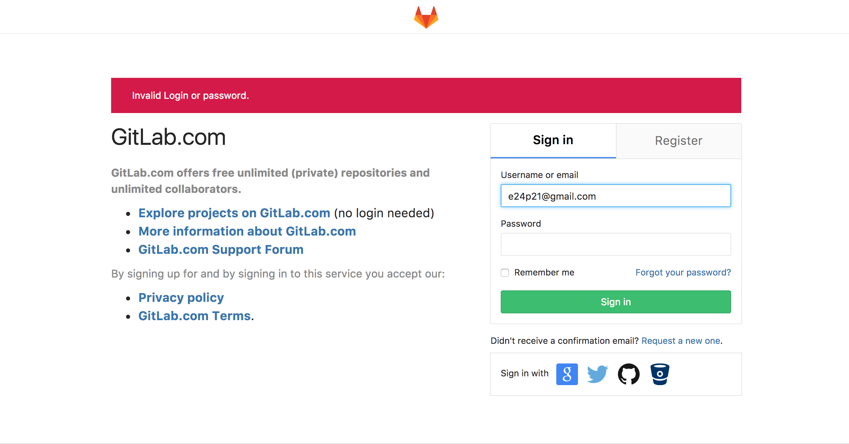

Slide 92
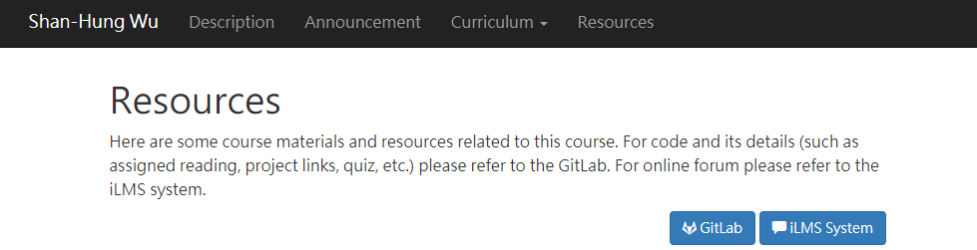
Here!!!!!

Slide 93
Outline
General Rule
Introduction to Git
Version control
Git Basics
Try Git!
Remote Repositories
How to Submit Your Code to Gitlab
Tools & References

Slide 94
Tools
Git GUI
GitKraken
Editor / IDE
Visual Studio Code
Atom
Sublime Text
Brackets
Notepad++
Webstorm

Slide 100
Reference
Learn Git branching (interactive)
http://pcottle.github.io/learnGitBranching/
Pro Git
http://git-scm.com/book/
寫給大家的 Git 教學
http://www.slideshare.net/littlebtc/git-5528339

Slide 101
Today’s exercise
Install Git command line tool in your computer.
Follow appendix A.
Try to submit in GitLab.

